Slide 1

CSE 2006 - Programming in Java Course Type: LP Credits: 3

Slide 2
Unit-1 Contents
Java Introduction
Java Hello World, Java JVM, JRE and JDK, Difference between C & C++, Java Variables, Java Data Types, Java Operators, Java Input and Output, Java Expressions & Blocks, Java Comment
Java Flow Control
Java if...else, Java switch Statement, Java for Loop, Java for-each Loop, Java while Loop, Java break Statement, Java continue Statement

Slide 3
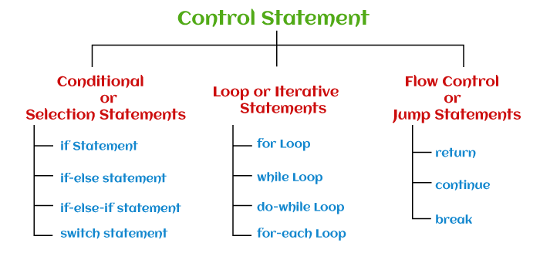
Java Flow Control
Control Statement
Control statements decide the flow (order or sequence of execution of statements) of a Java program. In Java, statements are parsed from top to bottom. Therefore, using the control flow statements can interrupt a particular section of a program based on a certain condition.
https://www.javatpoint.com/types-of-statements-in-java

Slide 4
Java Flow Control
here are the following types of control statements:
Conditional or Selection Statements
if Statement
if-else statement
if-else-if statement
Switch statement
Flow Control or Jump Statements
return
continue
break
Loop or Iterative Statements
For Loop
While Loop
do-while Loop
for-each Loop

Slide 5
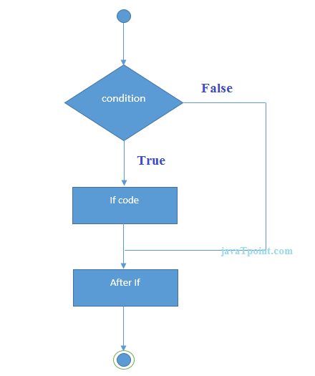
Java Flow Control
Java if Statement
The Java if statement tests the condition. It executes the if block if condition is true.
Syntax:
if(condition){
//code to be executed
}

Slide 6
Java Flow Control
//Java Program to demonstate the use of if statement.
public class IfExample {
public static void main(String[] args) {
//defining an 'age' variable
int age=20;
//checking the age
if(age>18){
System.out.print("Age is greater than 18");
}
}
}
Output:
Age is greater than 18

Slide 7
Java Flow Control
//A Java Program to demonstrate the use of if-else statement.
//It is a program of odd and even number.
public class IfElseExample {
public static void main(String[] args) {
//defining a variable
int number=13;
//Check if the number is divisible by 2 or not
if(number%2==0){
System.out.println("even number");
}else{
System.out.println("odd number");
}
}
}
Output:
odd number

Slide 8
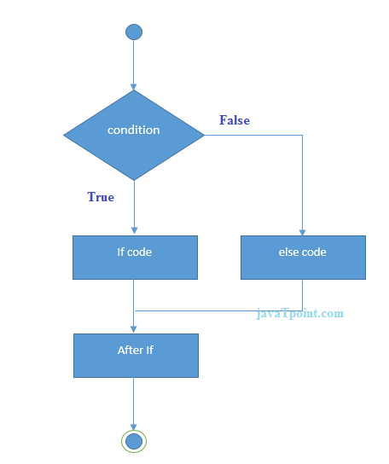
Java Flow Control
Java if-else Statement
The Java if-else statement also tests the condition. It executes the if block if condition is true otherwise else block is executed.
Syntax:
if(condition){
//code if condition is true
}else{
//code if condition is false
}

Slide 9
Java Flow Control
Leap Year Example:
A year is leap, if it is divisible by 4 and 400. But, not by 100.
public class LeapYearExample {
public static void main(String[] args) {
int year=2020;
if(((year % 4 ==0) && (year % 100 !=0)) || (year % 400==0)){
System.out.println("LEAP YEAR");
}
else{
System.out.println("COMMON YEAR");
}
}
}
Output:
LEAP YEAR

Slide 10
Java Flow Control
Using Ternary Operator
We can also use ternary operator (? :) to perform the task of if...else statement. It is a shorthand way to check the condition. If the condition is true, the result of ? is returned. But, if the condition is false, the result of : is returned.
Example:
public class IfElseTernaryExample {
public static void main(String[] args) {
int number=13;
//Using ternary operator
String output=(number%2==0)?"even number":"odd number";
System.out.println(output);
}
}
Output:
odd number

Slide 11
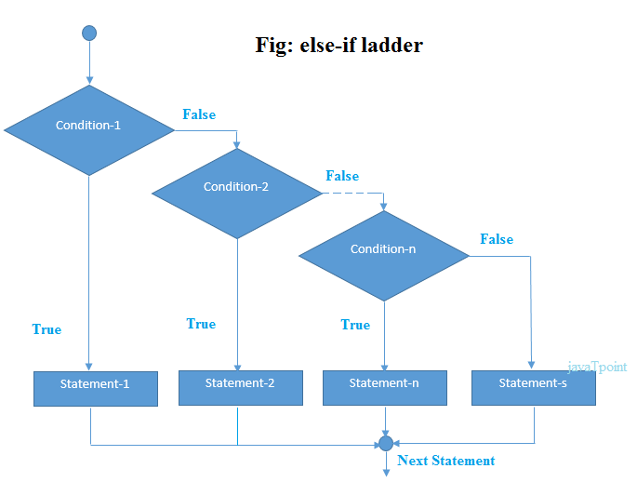
Java Flow Control
Java if-else-if ladder Statement

Slide 12
Java Flow Control
Java if-else-if ladder Statement
The if-else-if ladder statement executes one condition from multiple statements.
Syntax:
if(condition1){
//code to be executed if condition1 is true
}else if(condition2){
//code to be executed if condition2 is true
}
else if(condition3){
//code to be executed if condition3 is true
}
...
else{
//code to be executed if all the conditions are false
}

Slide 13
Java Flow Control
Example:
//Java Program to demonstrate the use of If else-if ladder.
//It is a program of grading system for fail, D grade, C grade, B grade, A grade and A+.
public class IfElseIfExample {
public static void main(String[] args) {
int marks=65;
if(marks<50){
System.out.println("fail");
}
else if(marks>=50 && marks<60){
System.out.println("D grade");
}
else if(marks>=60 && marks<70){
System.out.println("C grade");
}

Slide 14
Java Flow Control
else if(marks>=70 && marks<80){
System.out.println("B grade");
}
else if(marks>=80 && marks<90){
System.out.println("A grade");
}else if(marks>=90 && marks<100){
System.out.println("A+ grade");
}else{
System.out.println("Invalid!");
}
}
}
Output:
C grade

Slide 15
Java Flow Control
Program to check POSITIVE, NEGATIVE or ZERO:
public class PositiveNegativeExample {
public static void main(String[] args) {
int number=-13;
if(number>0){
System.out.println("POSITIVE");
}else if(number<0){
System.out.println("NEGATIVE");
}else{
System.out.println("ZERO");
}
}
}
Output:
NEGATIVE

Slide 16
Java Flow Control
Java Nested if statement
The nested if statement represents the if block within another if block. Here, the inner if block condition executes only when outer if block condition is true.
Syntax:
if(condition){
//code to be executed
if(condition){
//code to be executed
}
}

Slide 17
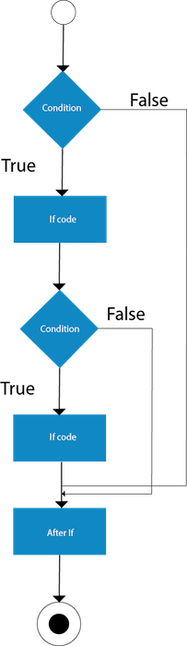
Java Flow Control
Java Nested if statement

Slide 18
Java Flow Control
Example:
//Java Program to demonstrate the use of Nested If Statement.
public class JavaNestedIfExample {
public static void main(String[] args) {
//Creating two variables for age and weight
int age=20;
int weight=80;
//applying condition on age and weight
if(age>=18){
if(weight>50){
System.out.println("You are eligible to donate blood");
}
}
}}
Output:
You are eligible to donate blood

Slide 19
Java Flow Control
Example:
//Java Program to demonstrate the use of Nested If Statement.
public class JavaNestedIfExample {
public static void main(String[] args) {
//Creating two variables for age and weight
int age=20;
int weight=80;
//applying condition on age and weight
if(age>=18){
if(weight>50){
System.out.println("You are eligible to donate blood");
}
}
}}
Output:
You are eligible to donate blood

Slide 20
Java Simple for Loop
A simple for loop is the same as C/C++. We can initialize the variable, check condition and increment/decrement value. It consists of four parts:
Initialization: It is the initial condition which is executed once when the loop starts. Here, we can initialize the variable, or we can use an already initialized variable. It is an optional condition.
Condition: It is the second condition which is executed each time to test the condition of the loop. It continues execution until the condition is false. It must return boolean value either true or false. It is an optional condition.
Increment/Decrement: It increments or decrements the variable value. It is an optional condition.
Statement: The statement of the loop is executed each time until the second condition is false.

Slide 21
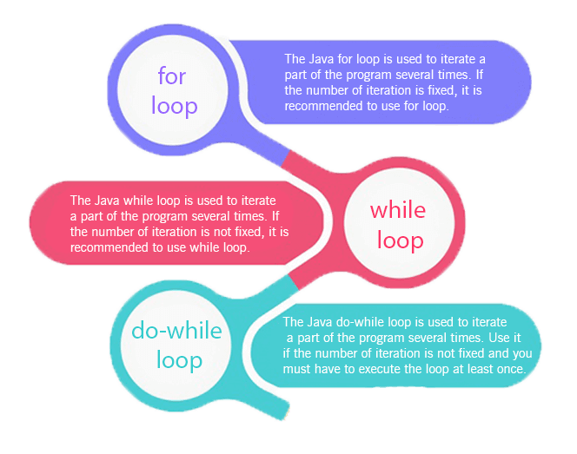
Loops in Java
The Java for loop is used to iterate a part of the program several times. If the number of iteration is fixed, it is recommended to use for loop. There are three types of for loops in Java.

Slide 22
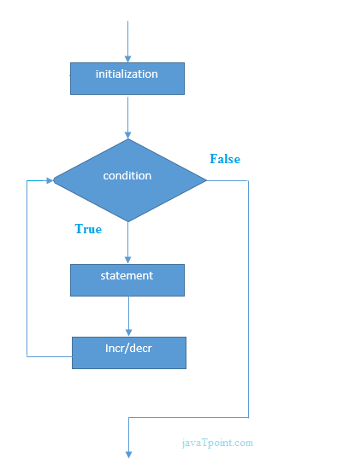
Java Simple for Loop
Syntax
for(initialization; condition; increment/decrement){
//statement or code to be executed
}

Slide 23
Java Simple for Loop
Example:
ForExample.java
//Java Program to demonstrate the example of for loop
//which prints table of 1
public class ForExample {
public static void main(String[] args) {
//Code of Java for loop
for(int i=1;i<=10;i++){
System.out.println(i);
}
}
}
Output:
1 2 3 4 5 6 7 8 9 10

Slide 24
Java Nested for Loop
If we have a for loop inside the another loop, it is known as nested for loop. The inner loop executes completely whenever outer loop executes.
NestedForExample.java
public class NestedForExample {
public static void main(String[] args) {
//loop of i
for(int i=1;i<=3;i++){
//loop of j
for(int j=1;j<=3;j++){
System.out.println(i+" "+j);
}//end of i
}//end of j
}
}
Output:
1 1
1 2
1 3
2 1
2 2
2 3
3 1
3 2
3 3

Slide 25
Java Nested for Loop
Pyramid Example 1:
PyramidExample.java
public class PyramidExample {
public static void main(String[] args) {
for(int i=1;i<=5;i++){
for(int j=1;j<=i;j++){
System.out.print("* ");
}
System.out.println();//new line
}
}
}
Output:
*
* *
* * *
* * * *
* * * * *

Slide 26
Java for-each Loop
The for-each loop is used to traverse array or collection in Java. It is easier to use than simple for loop because we don't need to increment value and use subscript notation.
It works on the basis of elements and not the index. It returns element one by one in the defined variable.
Syntax:
for(data_type variable : array_name){
//code to be executed
}

Slide 27
Java Nested for Loop
Example: ForEachExample.java
//Java For-each loop example which prints the
//elements of the array
public class ForEachExample {
public static void main(String[] args) {
//Declaring an array
int arr[]={12,23,44,56,78};
//Printing array using for-each loop
for(int i:arr){
System.out.println(i);
}
}
}
Output:
12
23
44
56
78

Slide 28
Java Infinitive for Loop
If you use two semicolons ;; in the for loop, it will be infinitive for loop.
Syntax:
for(;;){
//code to be executed
}

Slide 29
Java Infinitive for Loop
Example:
ForExample.java
//Java program to demonstrate the use of infinite for loop
//which prints an statement
public class ForExample {
public static void main(String[] args) {
//Using no condition in for loop
for(;;){
System.out.println("infinitive loop");
}
}
}
Output:
infinitive loop infinitive loop infinitive loop infinitive loop infinitive loop
ctrl+c
https://www.javatpoint.com/java-for-loop

Slide 30
Java While Loop
The Java while loop is used to iterate a part of the program repeatedly until the specified Boolean condition is true. As soon as the Boolean condition becomes false, the loop automatically stops.
The while loop is considered as a repeating if statement. If the number of iteration is not fixed, it is recommended to use the while loop.
Syntax:
while (condition){
//code to be executed
Increment / decrement statement
}
https://www.javatpoint.com/java-while-loop

Slide 31
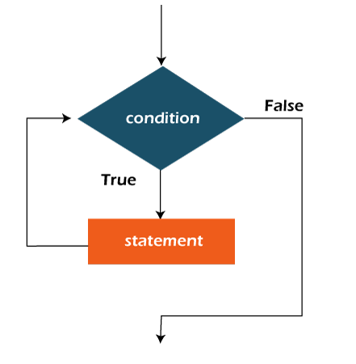
Java While Loop
Flowchart

Slide 32
Java While Loop
In the below example, we print integer values from 1 to 10. Unlike the for loop, we separately need to initialize and increment the variable used in the condition (here, i). Otherwise, the loop will execute infinitely.
WhileExample.java
public class WhileExample {
public static void main(String[] args) {
int i=1;
while(i<=10){
System.out.println(i);
i++;
}
}
}
Output:
1 2 3 4 5 6 7 8 9 10
https://www.javatpoint.com/java-while-loop

Slide 33
Java do-while Loop
The Java do-while loop is used to iterate a part of the program repeatedly, until the specified condition is true.
If the number of iteration is not fixed and you must have to execute the loop at least once, it is recommended to use a do-while loop. Java do-while loop is called an exit control loop.
Therefore, unlike while loop and for loop, the do-while check the condition at the end of loop body. The Java do-while loop is executed at least once because condition is checked after loop body.
Syntax:
do{
//code to be executed / loop body
//update statement
}while (condition);

Slide 34
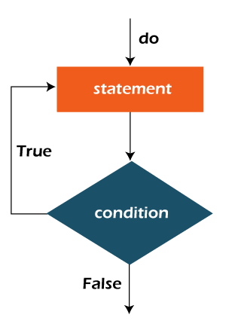
Java do-while Loop
Flowchart of do-while loop:

Slide 35
Java do-while Loop
In the below example, we print integer values from 1 to 10. Unlike the for loop, we separately need to initialize and increment the variable used in the condition (here, i). Otherwise, the loop will execute infinitely.
DoWhileExample.java
public class DoWhileExample {
public static void main(String[] args) {
int i=1;
do{
System.out.println(i);
i++;
}while(i<=10);
}
}
Output:
1 2 3 4 5 6 7 8 9 10
https://www.javatpoint.com/java-do-while-loop

Slide 36
Java Break Statement
When a break statement is encountered inside a loop, the loop is immediately terminated and the program control resumes at the next statement following the loop.
The Java break statement is used to break loop or switch statement. It breaks the current flow of the program at specified condition. In case of inner loop, it breaks only inner loop.
We can use Java break statement in all types of loops such as for loop, while loop and do-while loop.
Syntax:
jump-statement;
break;

Slide 37
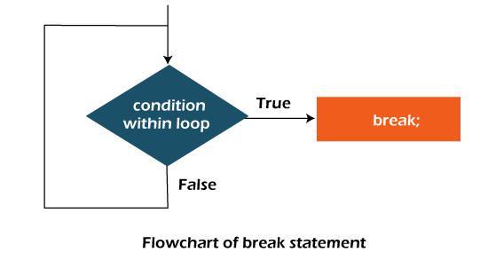
Java Break Statement
Flowchart of Break Statement

Slide 38
Java Break Statement with Loop
Example: BreakExample.java
//Java Program to demonstrate the use of break statement
public class BreakExample {
public static void main(String[] args) {
//using for loop
for(int i=1;i<=10;i++){
if(i==5){
//breaking the loop
break;
}
System.out.println(i);
}
}
}
Output:
1
2
3
4
https://www.javatpoint.com/java-break

Slide 39
Java Continue Statement
The continue statement is used in loop control structure when you need to jump to the next iteration of the loop immediately. It can be used with for loop or while loop.
The Java continue statement is used to continue the loop. It continues the current flow of the program and skips the remaining code at the specified condition. In case of an inner loop, it continues the inner loop only.
We can use Java continue statement in all types of loops such as for loop, while loop and do-while loop.
Syntax:
jump-statement;
continue;

Slide 40
Java Continue Statement
ContinueExample.java
//Java Program to demonstrate the use of continue statement
public class ContinueExample {
public static void main(String[] args) {
//for loop
for(int i=1;i<=10;i++){
if(i==5){
//using continue statement
continue;//it will skip the rest statement
}
System.out.println(i);
}
}
}
Output:
1 2 3 4 5 6 7 8 9 10
https://www.javatpoint.com/java-continue

Slide 41
Java Comments
The Java comments are the statements in a program that are not executed by the compiler and interpreter.
Why do we use comments in a code?
Comments are used to make the program more readable by adding the details of the code.
It makes easy to maintain the code and to find the errors easily.
The comments can be used to provide information or explanation about the variable, method, class, or any statement.
It can also be used to prevent the execution of program code while testing the alternative code.
Types of Java Comments
There are three types of comments in Java.
Single Line Comment
Multi Line Comment
Documentation Comment

Slide 42
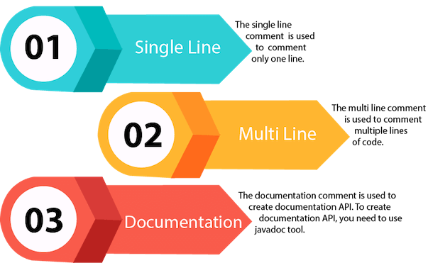
Types of Java Comments

Slide 43
More Java Links
How to Run Java Program in Command Prompt (JDK Installation)
https://youtu.be/F3Mh6NS69Z0
Java Programming reference Links
https://www.javatpoint.com/java-tutorial
https://www.w3schools.com/java/default.asp
https://www.tutorialspoint.com/java/index.htm
https://simplesnippets.tech/courses/core-java-programming-tutorials-for-beginners/
Java Full Course In 11 Hours | Java Programming |Simplilearn
https://youtu.be/CFD9EFcNZTQ
Simply learn for java
https://www.youtube.com/hashtag/javatutorialforbeginners

